Slide 1

ANOMALY RECOGNITION FROM SURVEILLANCE VIDEOS USING CONVOLUTION NEURAL NETWORK
Advanced Machine Learning (BA-64061-001) Final Project
By
Yeswanth Siripurapu

Slide 2
Introduction
Action Recognition, a sub space of vision related applications, is the capacity to distinguish and perceive the activities or objectives of the specialist, the specialist can be any item or substance that performs activity, which has ultimate objectives. The specialist can be a solitary specialist playing out the activity or gathering of specialists playing out the activities or having some communication
Observing is much of the time performed through sequential edges which are extricated from the video. The whole system is isolated into two sections. In the initial segment, the elements are registered from video outlines and in second part, in light of the got highlights classifier foresee the class as dubious or ordinary.

Slide 3
Objective
The main objective of the project can anticipate dubious or ordinary human conduct in the recording which is utilized to help the observing system. The majority of the ongoing framework utilizes the recordings acquired from CCTV cameras. On the off chance that any wrongdoing or viciousness occurs, this video will be utilized for examination reason.
Yet, assuming that we consider a framework which will consequently distinguishes what is happening ahead of time and an instrument to caution the separate authority is really fascinating and which can be applied to indoor and outside places.

Slide 4
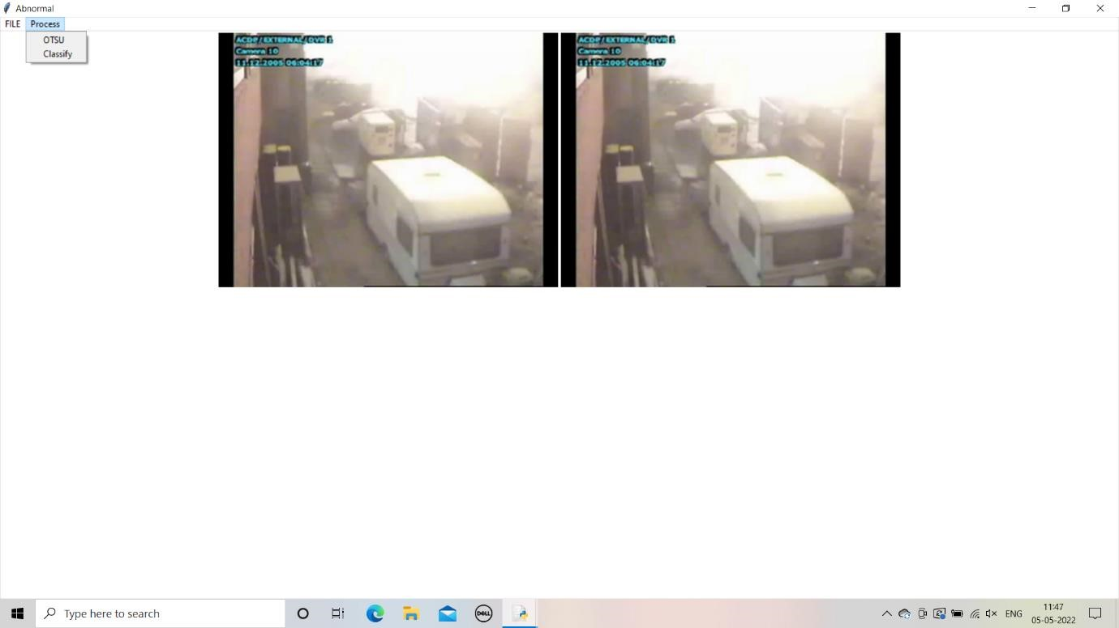
Implementation & Results
Open python idle (python idle 3,7-64bit) and select the code file
Run the module of code File
After that process import the input of sample video of Anomaly occurs
After taking the input sample video it plays the video completely and the frame process is started and all frames are collected and displayed in the second image

Slide 5
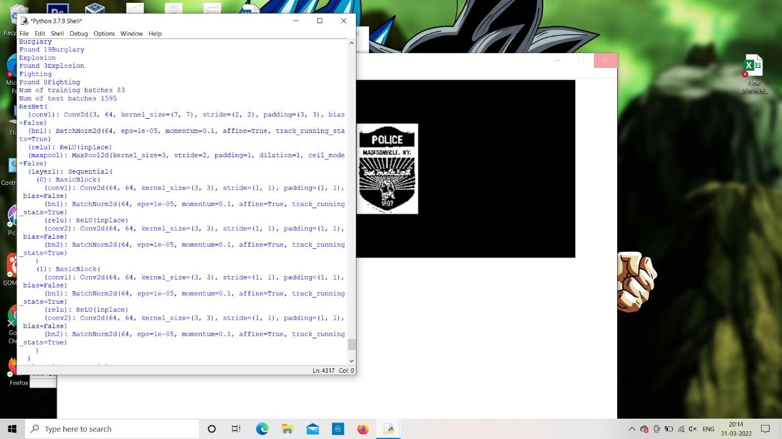
Resnet 18 Neural Network
We have click on classify then frame process is started and by using Resnet 18 among the all the frames in the video should be classify and give the output frames of Anomaly happened in the video.

Slide 6
Evaluating Accuracy and value loss
Later that the frame process is completed then it it occurs total of 80 steps and the occurs and value loss we can see for every 20 steps and then the result is displayed with the respective frames that anomaly occurs in given sample input video.
Accuracy and value loss is not same for every time it have change due to if it reads more frames it may change.

Slide 7
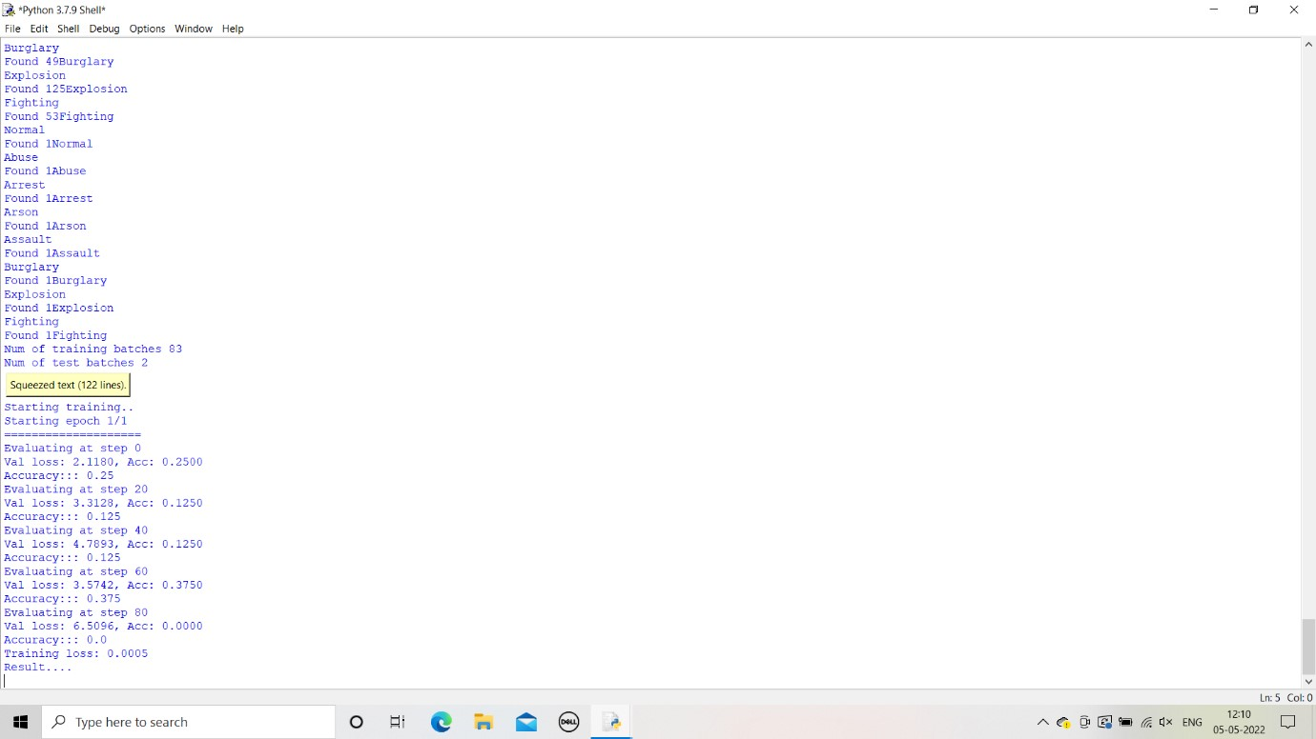
Accuracy

Slide 8
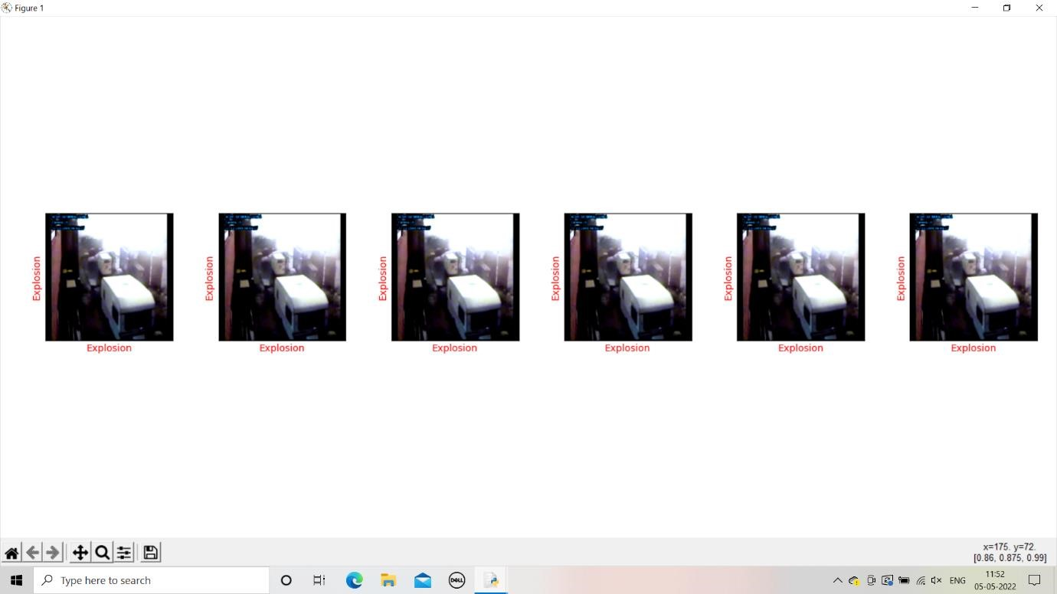
Results

Slide 9
GitHub Link to access the project files, code & Reports
https://github.com/yeswanth1siripurapu/yeswanthsiripurapu_64061-AML.git

Slide 10
THANK YOU

